Slide 1


Slide 2
The Team
Supervisors:
Dr. M.H. Khan
Mr. Ritendra Goel
Team members :
Aakanksha Verma 1405210001
Abhishek Gupta 1405210004
Himanshu Yadav 14052 51022

Slide 3
Objective
“To enable the user to store his/her different types of contact details, including other personal details, and allowing them to share this stored data to other users of the application in the most secure, customized, fast and easy manner, without explicitly needing any mechanism on the users’ part.”

Slide 4
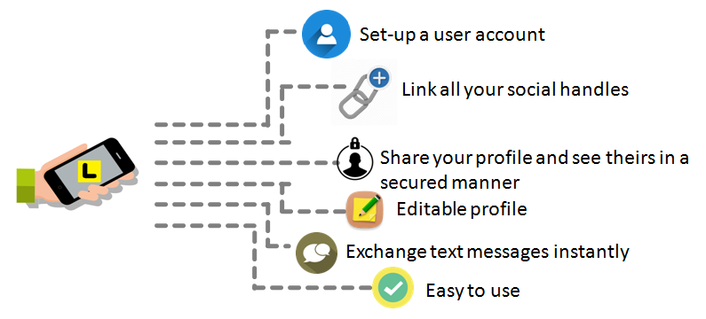
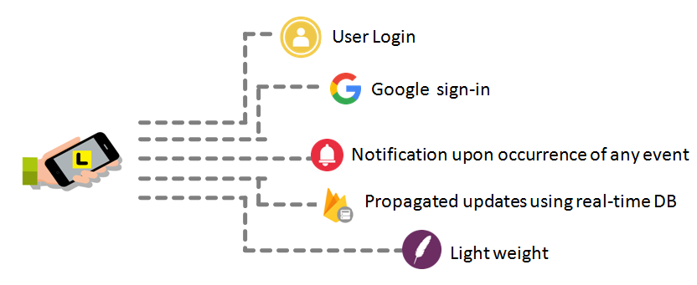
Features

Slide 5
Need
Emergency numbers can be easily accessed in case of need.
Scope
Used by general public for personal use.
Can be used for publicity of anything from a new shop to a new restaurant or a start-up needing to spread its contact details.
Exclusive groups pertaining to a particular organization can be formed making use of this application, and share their contact details for smooth communication among themselves.
Collaboration of all the social media accounts makes ones life easy. No fuss in contacting people through various social accounts.
Invitations for any occasion can be sent on the fly with no last minute chaos in searching of the latest addresses and phone numbers of the long forgotten relatives whom one seldom interacts with on daily basis.
No worries of the data being lost. Every is backed-up on the cloud.

Slide 6

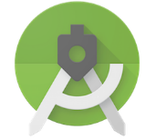



Development Tools
Developer:
Microsoft Windows 7/8/10 (32-bit or 64-bit)2 GB RAM minimum, 8 GB RAM recommended.2 GB of available disk space minimum, 4 GB Recommended (500 MB for IDE + 1.5 GB for Android SDK and emulator system image)1280 x 800 minimum screen resolution.
Kotlin Language
Tools: Android studio, Adobe Photoshop, Github, Firebase
User:
10 Mb free space.
Android version Kitkat or above.
Android Studio
Firebase
Adobe Photoshop
Github
For App designing,
development and testing
For Server Side
application and database
For designing and
optimizing graphics
For Development
Collaboration

Slide 7
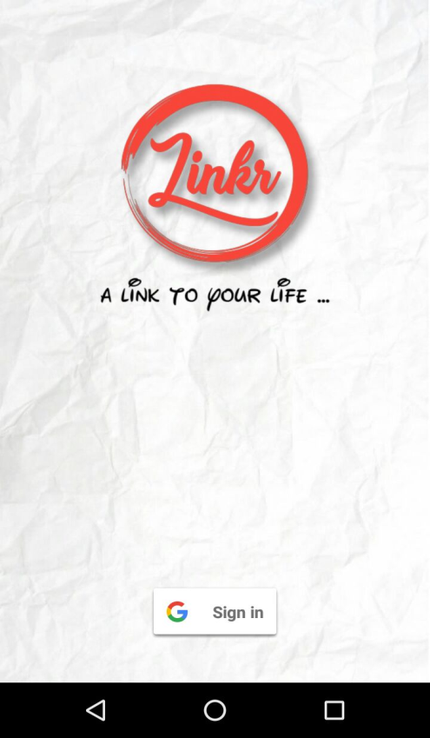
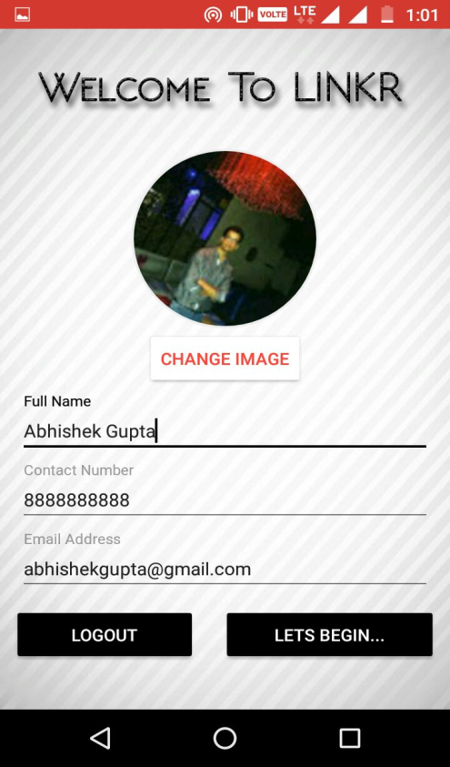
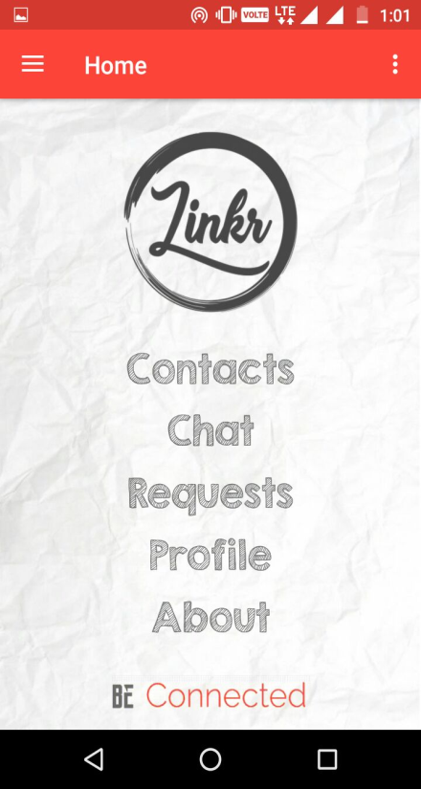
For the first time use of the app , you have to setup your profile by entering your name , email , phone number and your profile picture
Click on Lets Begin… Button when you are ready. Next Home Screen of the app will be displayed.
Login Screen Appears , Click on Sign In Button to choose account to login

Slide 8
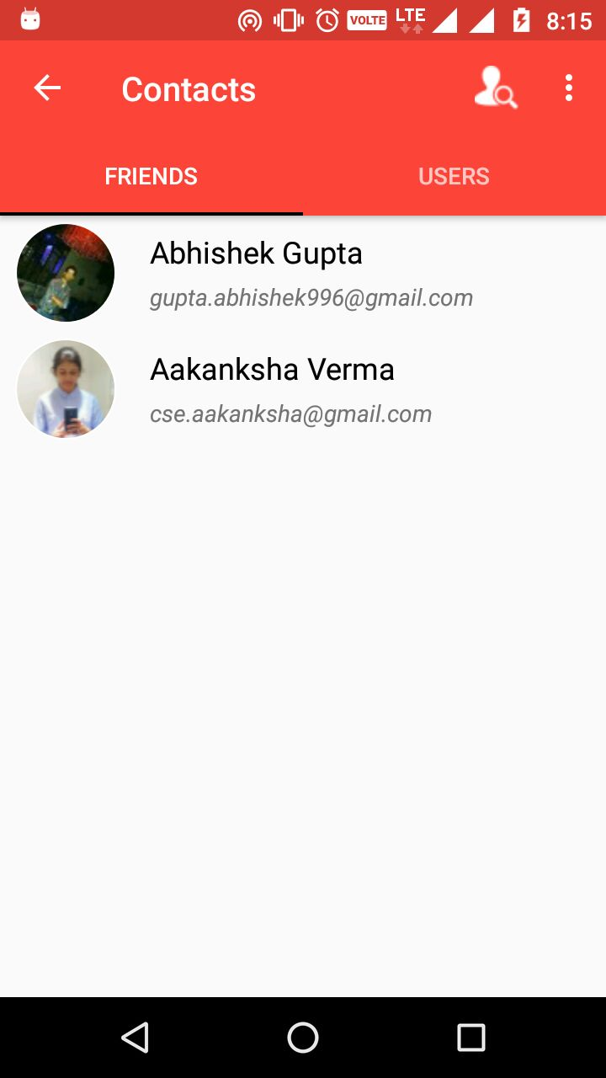
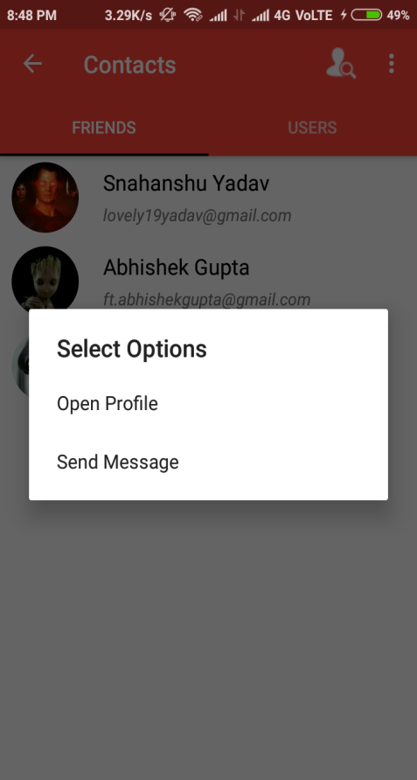
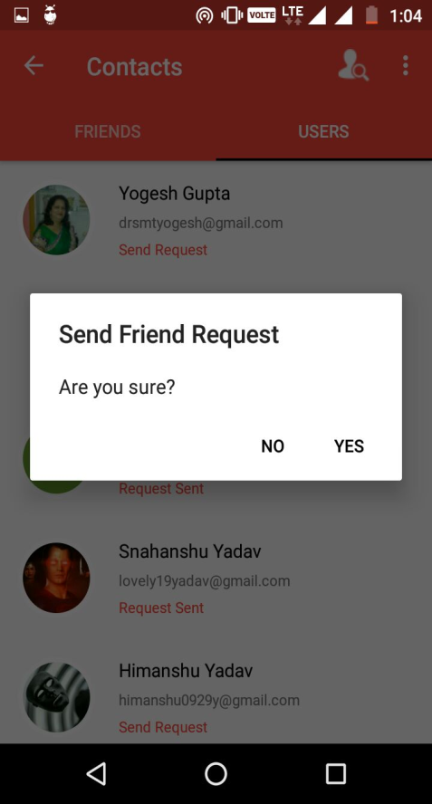
Contacts section has two tabs
One for the users that are friends
Other for all the users using the Linkr App
On clicking a user there are two cases:
If the user is a friend then we can view his profile or start chatting with him
2. If the user is not a friend in the app , then we can view his public profile and send him friend request

Slide 9
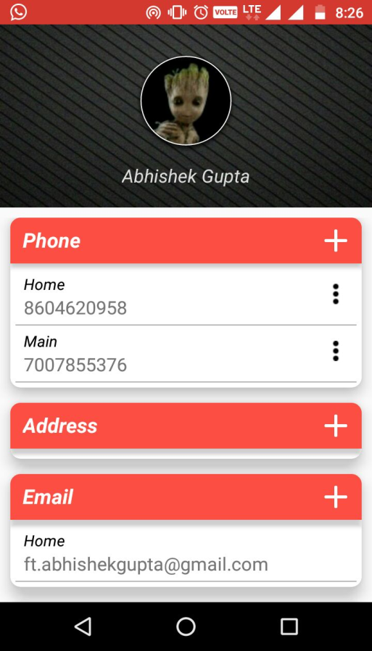
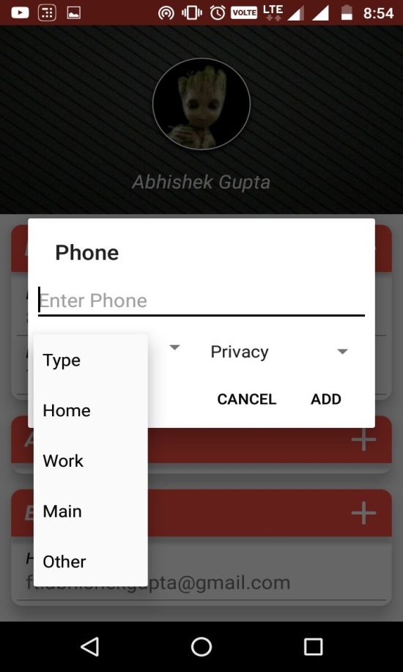
The edit profile window gives user the access to manage his/her profile. Each field in the profile can be customized with editable data and restricted privacy settings.
Plus sign can be clicked upon to add fields
using a dialog box where we can set the type of data and set privacy settings

Slide 10

Video Demonstration
Login using Gmail Account
First time user have to setup their account
All the users of the app are visible and their public profile can be viewed
When a friend request is accepted , two users become friends on the app
Friends can chat with each other using text data only.
People maintain their own profile and can easily manage their dynamic links.

Slide 11
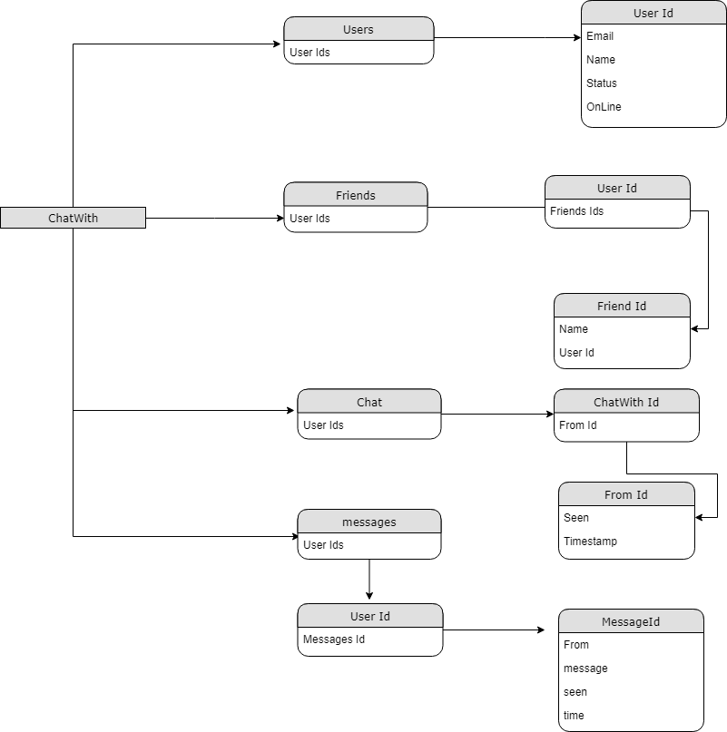
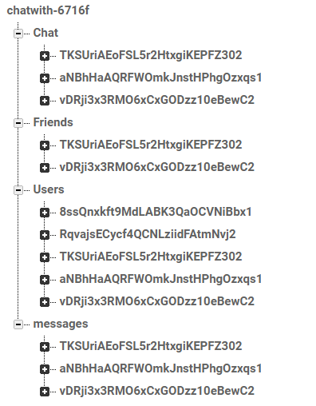
Back End Design
Database Structure
DB Diagram
(Chat Module)

Slide 12
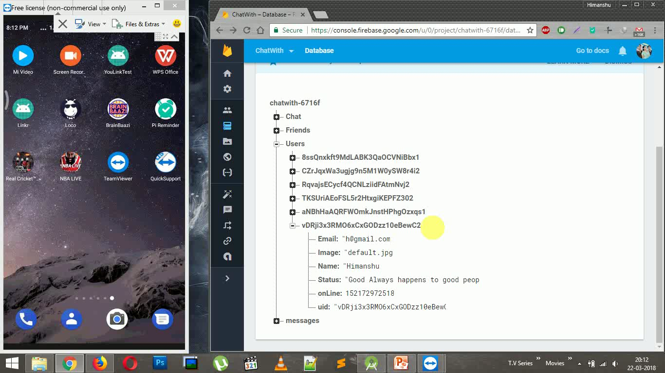
Back End Working

Slide 13

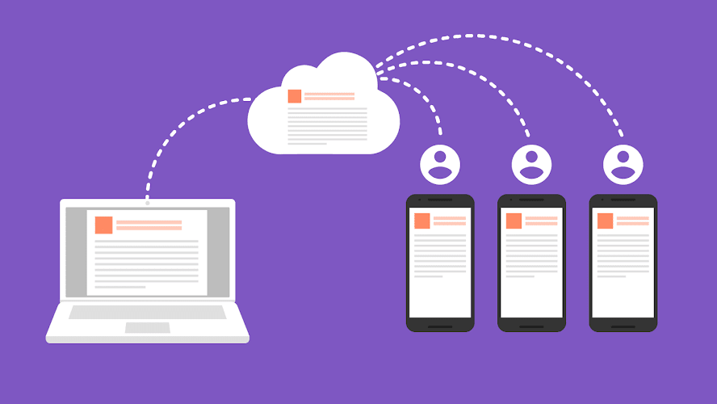
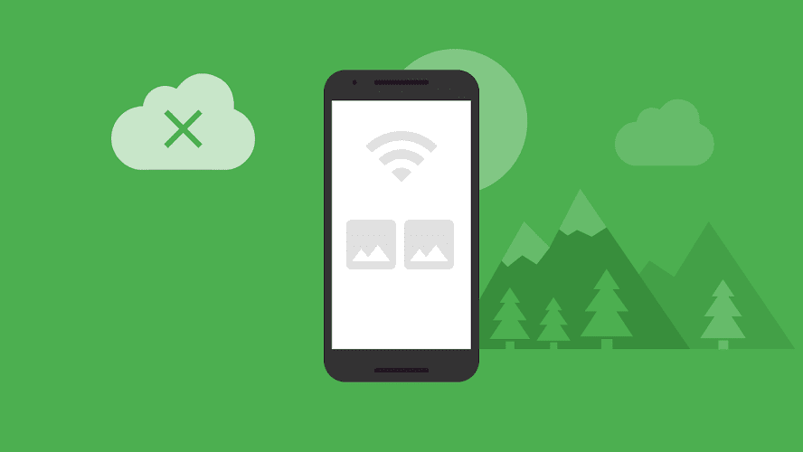
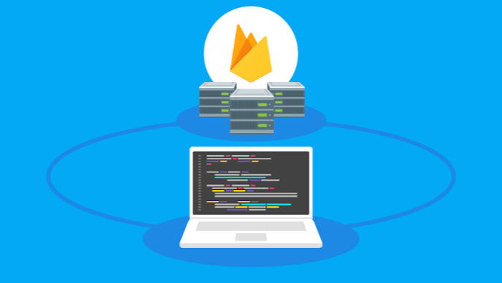
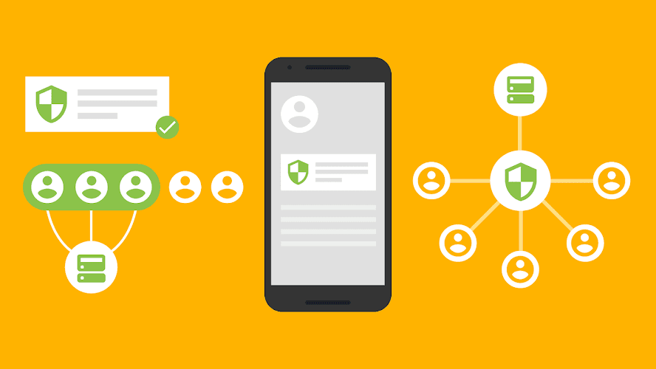
Firebase – Realtime Database
The Firebase Realtime Database is a cloud-hosted NoSQL database that lets you store and sync data between your users in realtime.
Automatic sync
1 GB Free Storage the can store huge amount of text based data
Offline support
Easy to implement
Supports Android , iOS and webapps
Collaborate across devices with ease
Optimized for offline use
Build serverless apps
Strong user-based security

Slide 14
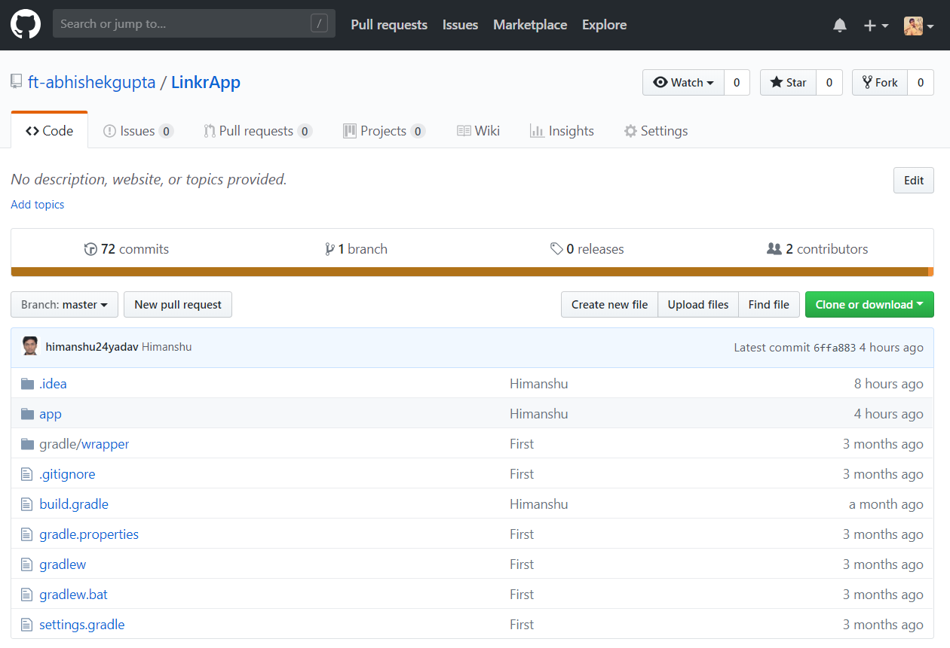
Github Console

Slide 15
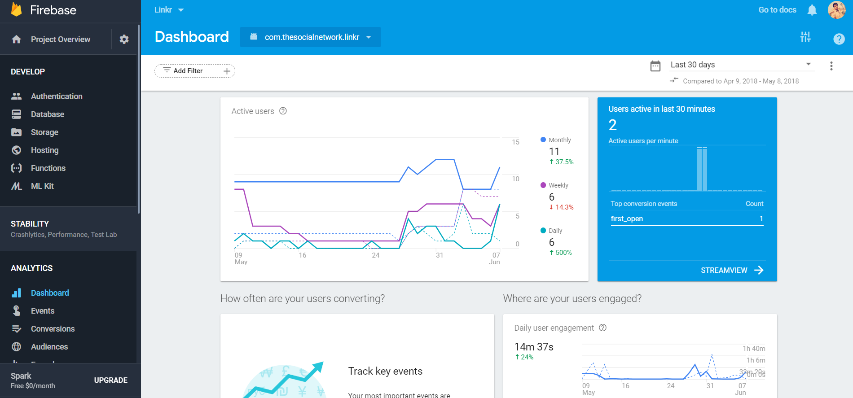
Firebase Console

Slide 16
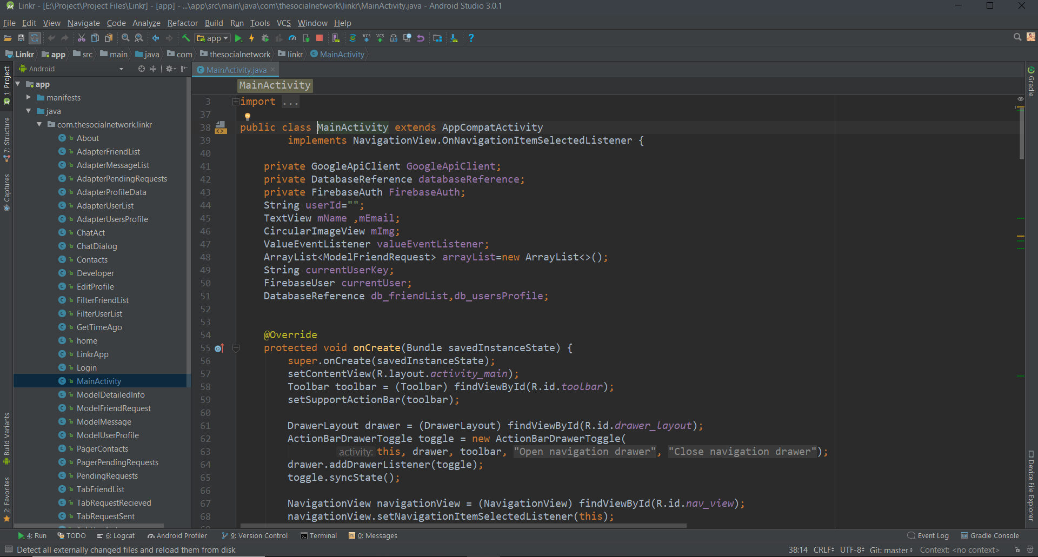
Android Studio Console

Slide 17

Linkr has been developed to make people’s life easier. It is free from any complexity of usage, size overhead, functions perfectly fine even in slow data connection and is freely available and easily downloadable from the Google Play Store within seconds.
Linkr lets its users integrate, collaborate, share and update their contact information in real-time which increases its usefulness in this world where change is the only constant. Linkr links all your accounts at one place and also links you to all your cared ones hence, indeed acting as a link to your life!
To summarize linkr is:
“Simple enough that anyone can use it,
versatile enough that everyone has some use for it.”

